Slide 1
Structural Patterns

Slide 2
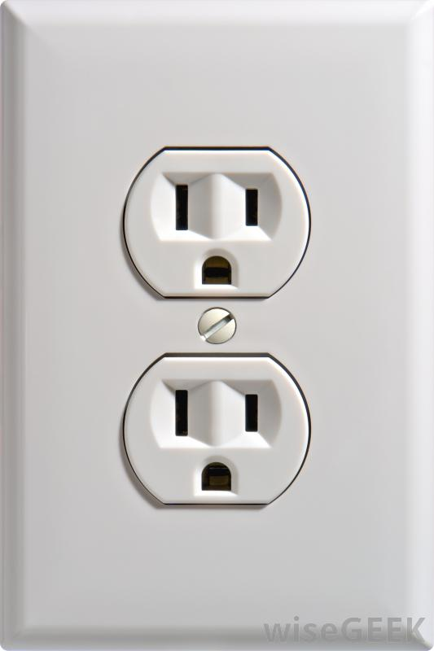

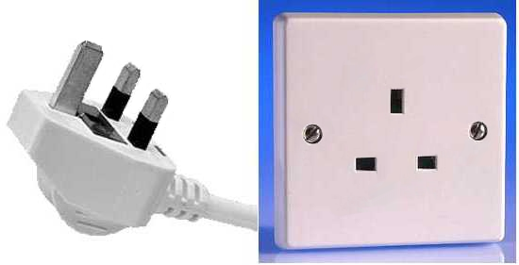
Motivation: Adapter

Slide 3
Adapter
Intent | Convert the interface of a class into another interface clients expect. Adapter lets classes work together that couldn't otherwise because of incompatible interfaces. Wrap an existing class with a new interface.
Problem | An "off the shelf" component offers compelling functionality that you would like to reuse, but its "view of the world" is not compatible with the philosophy and architecture of the system currently being developed.

Slide 4
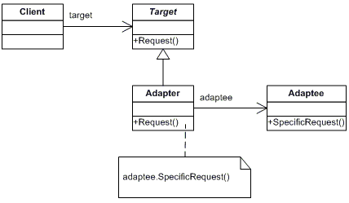
Solution

Slide 5
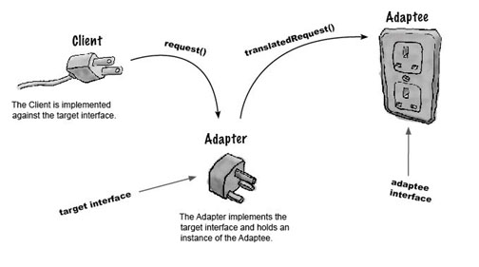
Example: Car Factory
Client
<<interface>>
PowerAdapter
+connectPower()
EuroInterface
USInterface
USSocket
+connectPower()
+connectPower()
+powerConnection()

Slide 6
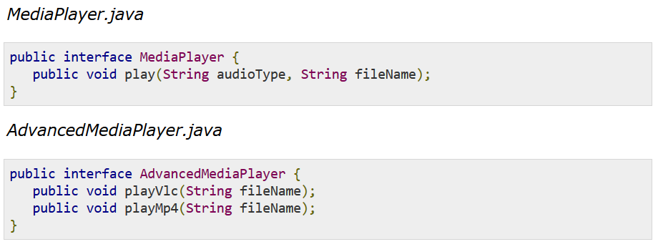
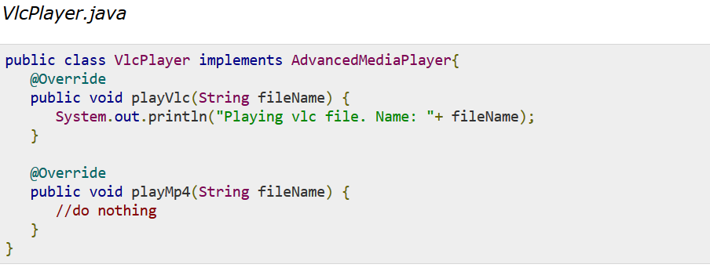

Slide 7
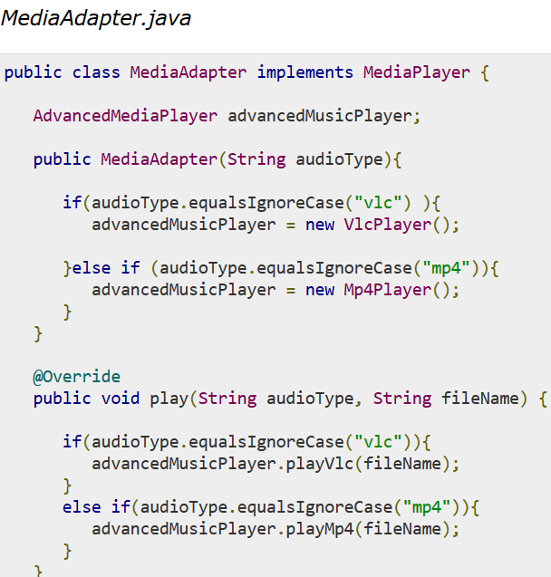

Slide 8
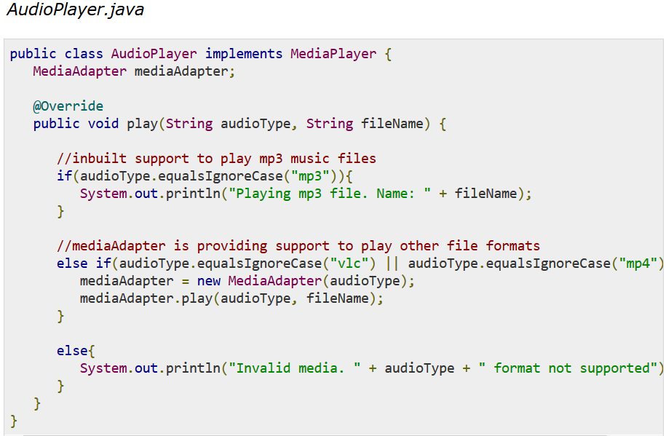
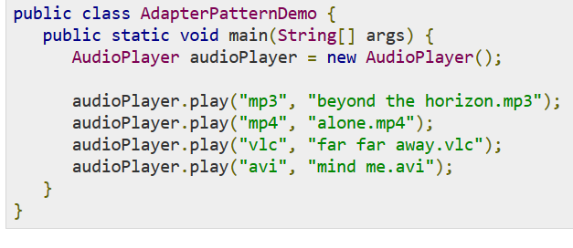

Slide 9
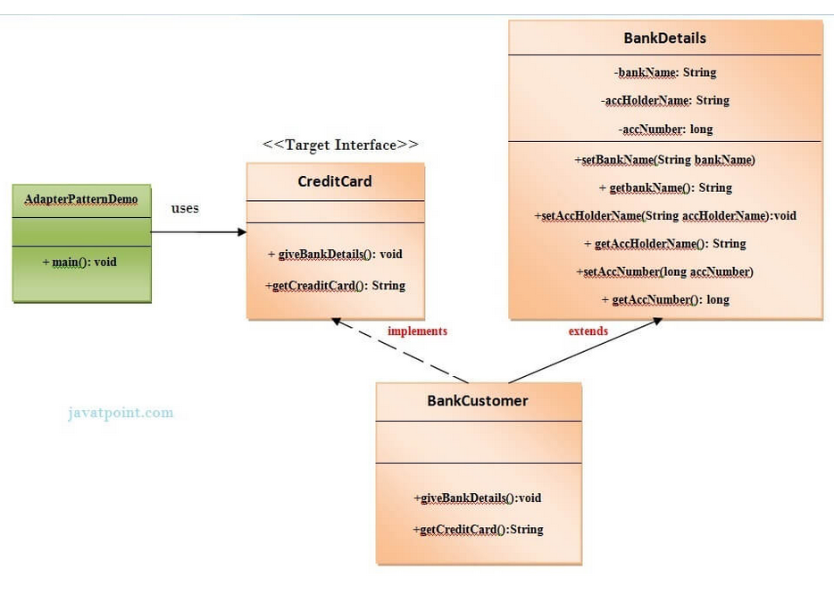
Adapter

Slide 10
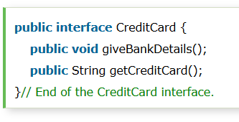
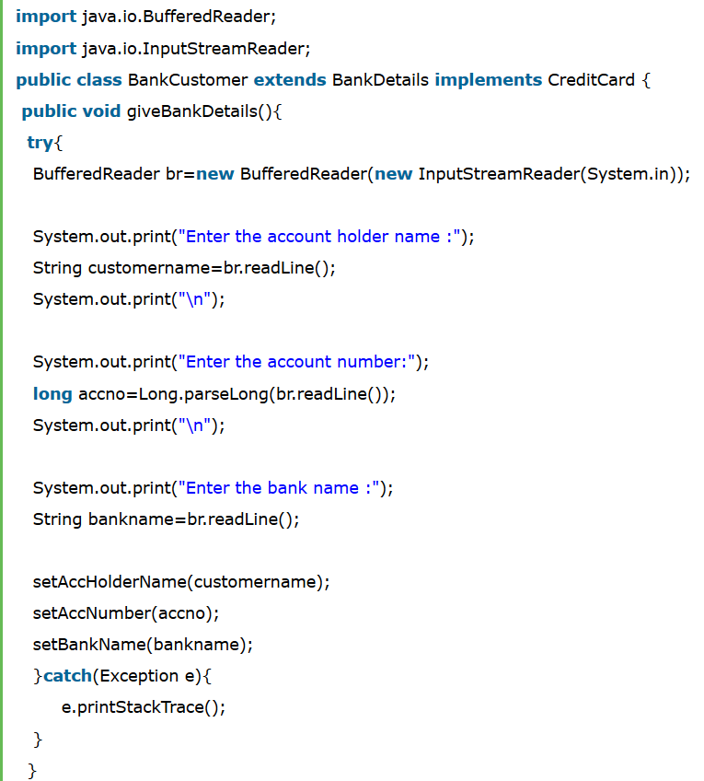
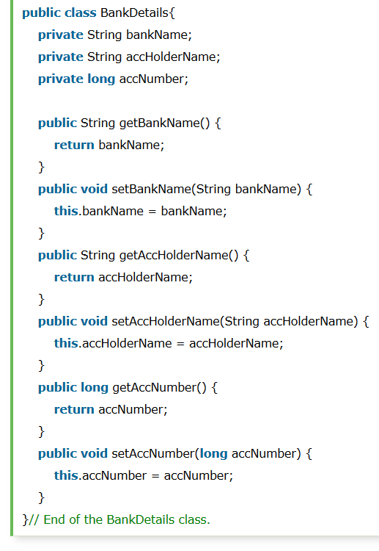

Slide 11
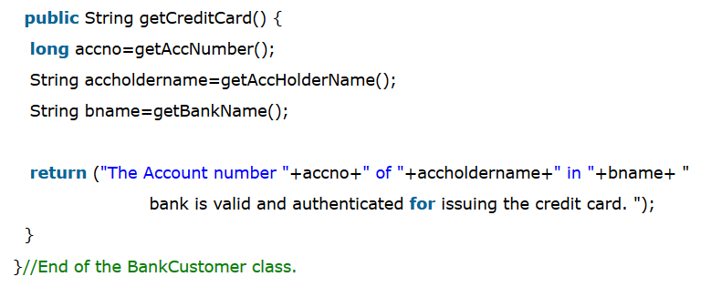
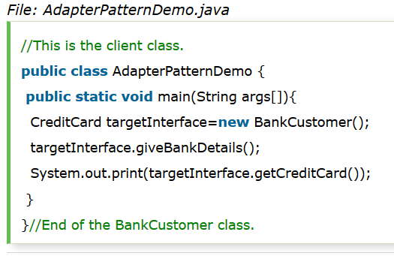

Slide 12
Consequences
Allows pre-existing classes to be used in your code.
Will not work if existing class is missing some key behavior.

Slide 13
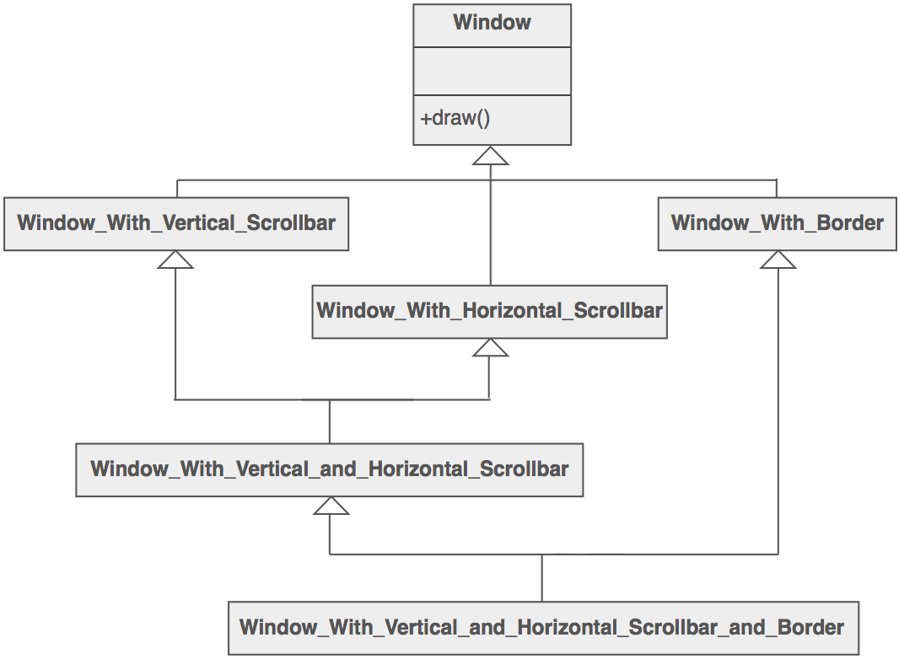
Motivation: Decorator

Slide 14
Decorator
Intent | Attach additional responsibilities to an object dynamically. Decorators provide a flexible alternative to subclassing for extending functionality. Client-specified embellishment of a core object by recursively wrapping it. Wrapping a gift, putting it in a box, and wrapping the box.
Problem | You want to add behavior or state to individual objects at run-time. Inheritance is not feasible because it is static and applies to an entire class.

Slide 15
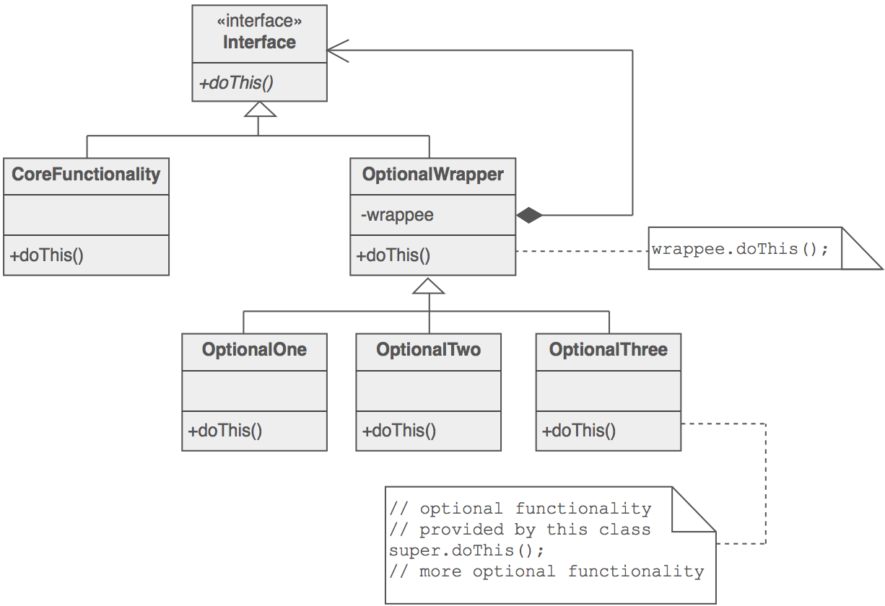
Solution

Slide 16
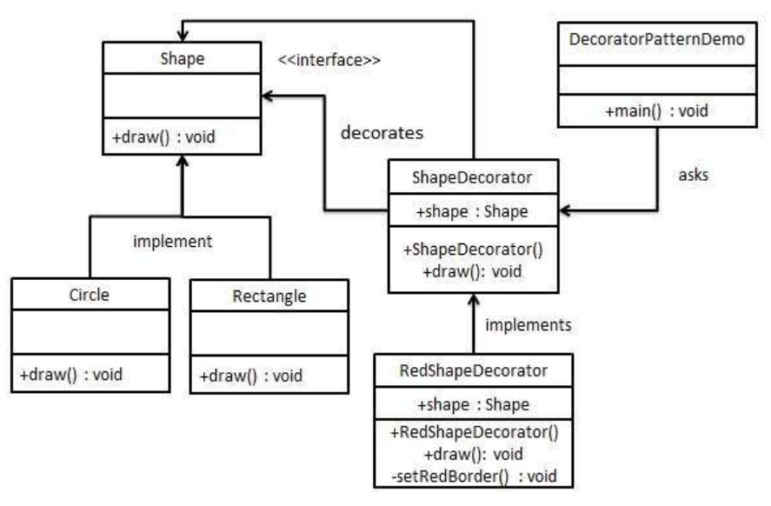

Slide 17
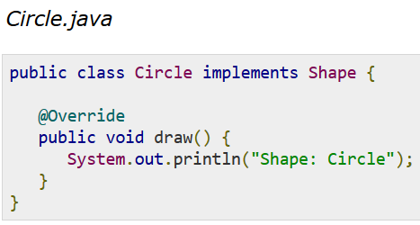
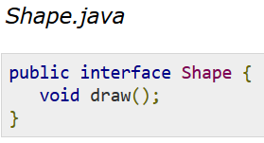
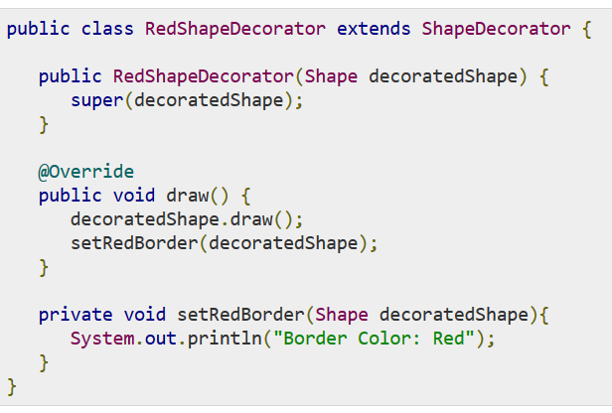

Slide 18
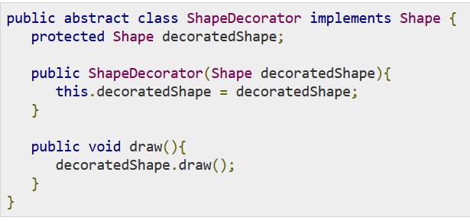
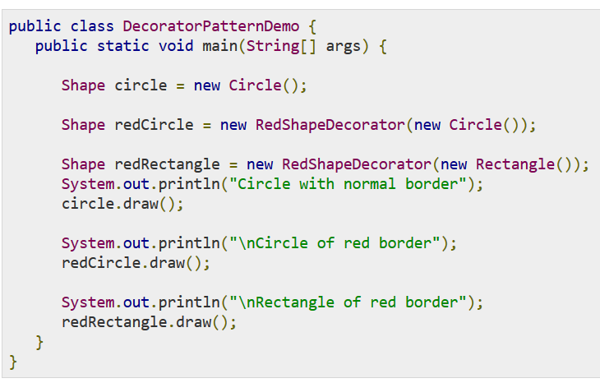

Slide 19
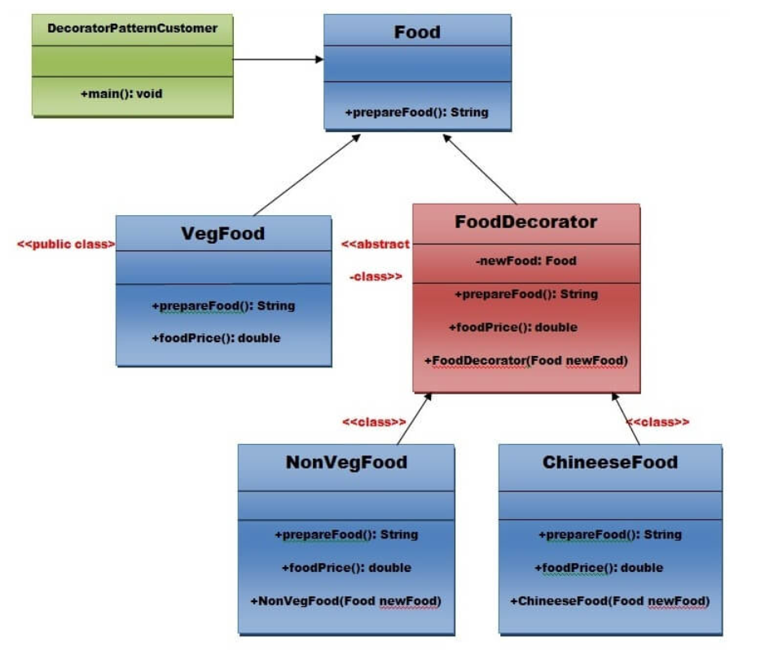
Decorator

Slide 20
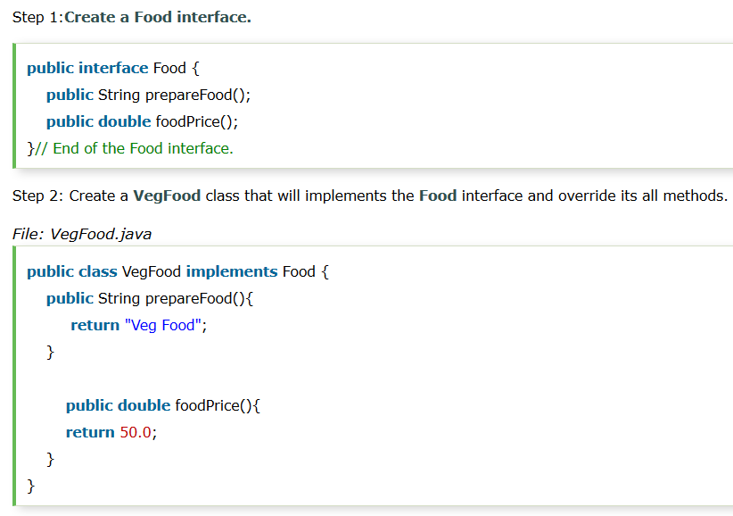

Slide 21
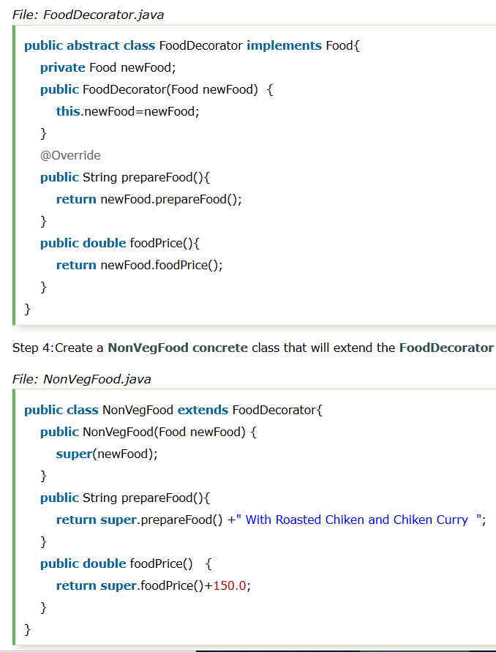

Slide 22
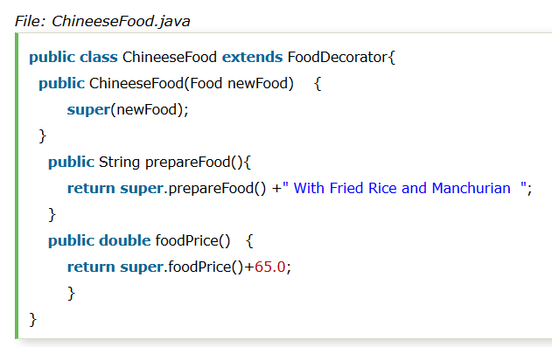

Slide 23
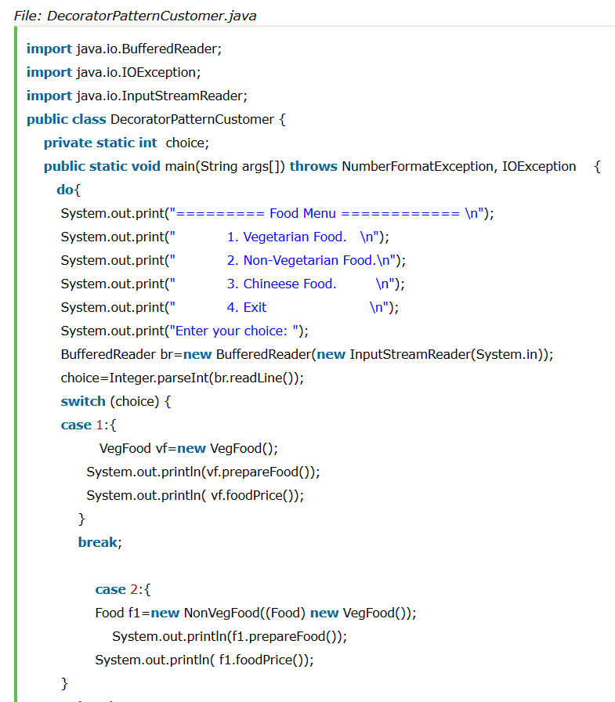

Slide 24
Consequences
More flexibility than static inheritance
Pay-as-you-go approach
Lots of little objects

Slide 25
Composite
Intent | Compose objects into tree structures to represent whole-part hierarchies. Composite lets clients treat individual objects and compositions of objects uniformly. Recursive composition
Problem | Application needs to manipulate a hierarchical collection of "primitive" and "composite" objects. Processing of a primitive object is handled one way, and processing of a composite object is handled differently. Having to query the "type" of each object before attempting to process it is not desirable.

Slide 26
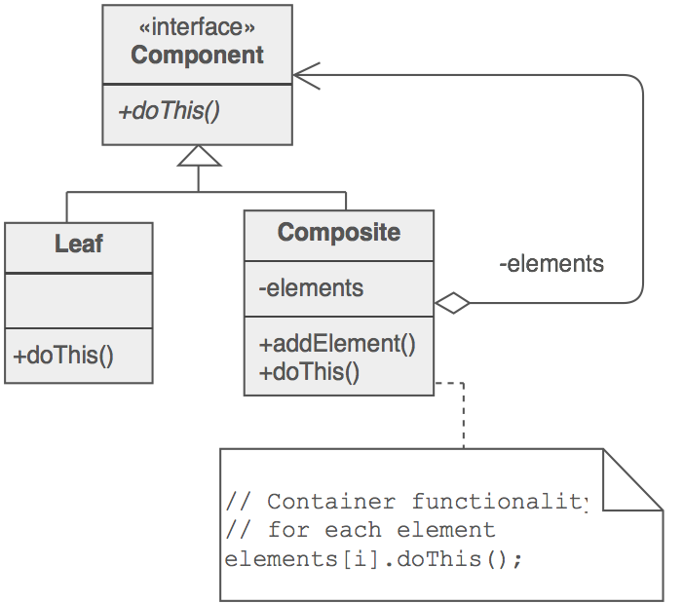
Components
Composite Pattern consists of following objects:
Base Component – Base component is the interface for all objects in the composition, client program uses base component to work with the objects in the composition. It can be an interface or an abstract class with some methods common to all the objects.
Leaf – Defines the behaviour for the elements in the composition. It is the building block for the composition and implements base component. It doesn’t have references to other Components.
Composite – It consists of leaf elements and implements the operations in base component.

Slide 27
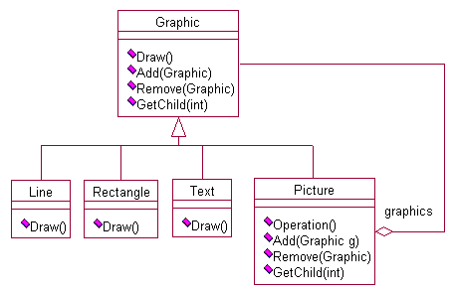
Example

Slide 28
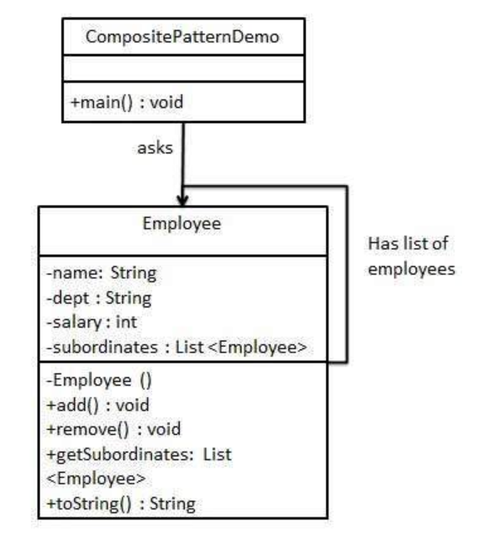

Slide 29
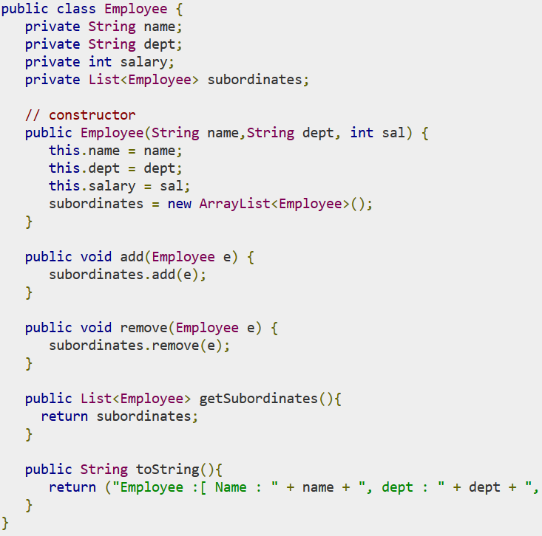

Slide 30
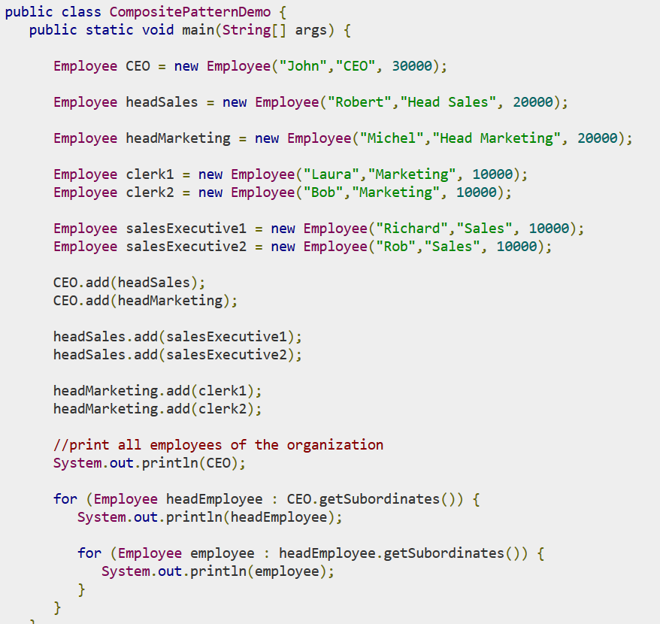

Slide 31
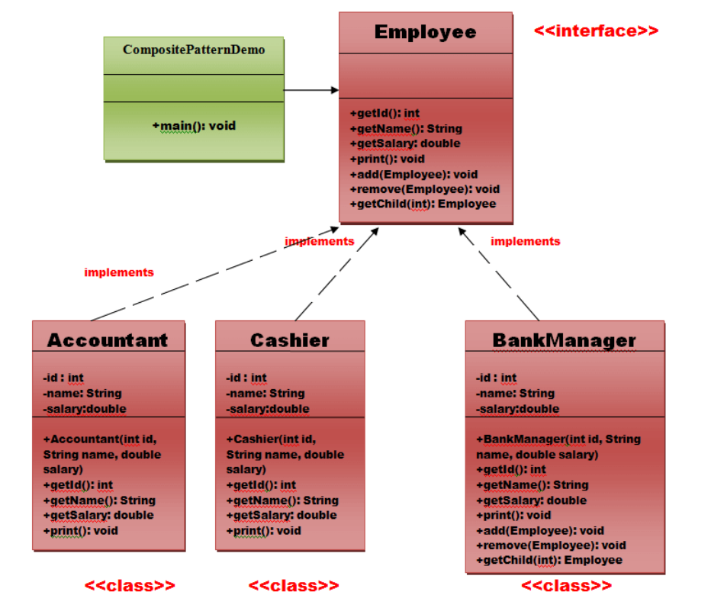

Slide 32
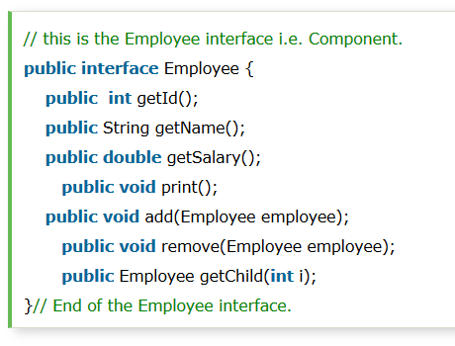
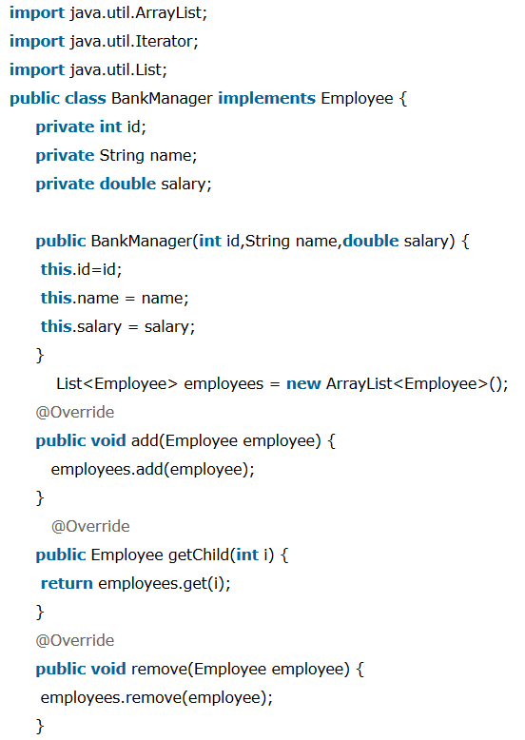

Slide 33
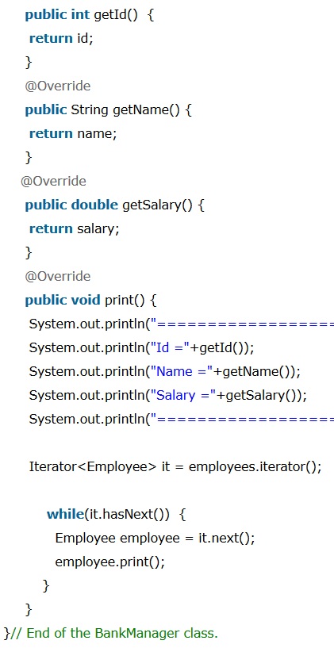
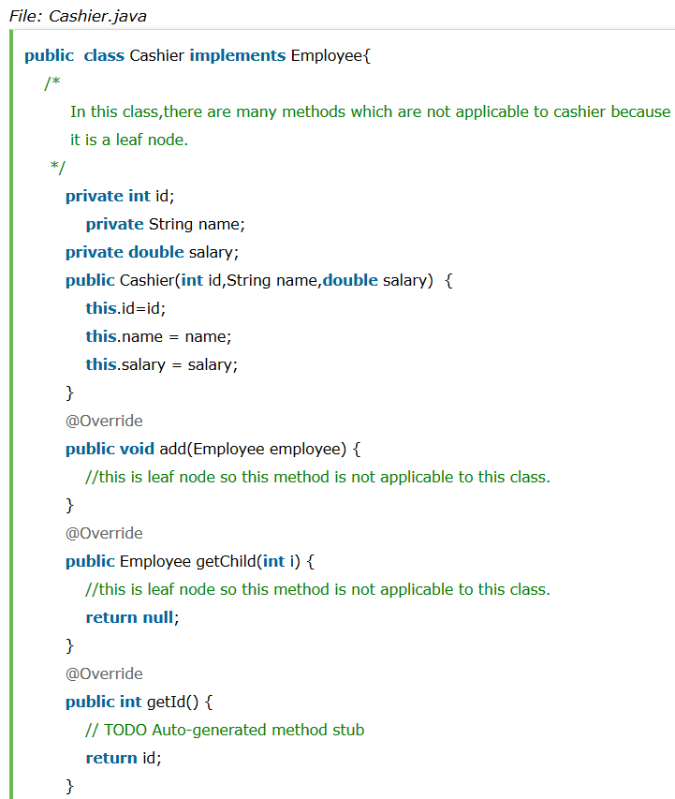

Slide 34
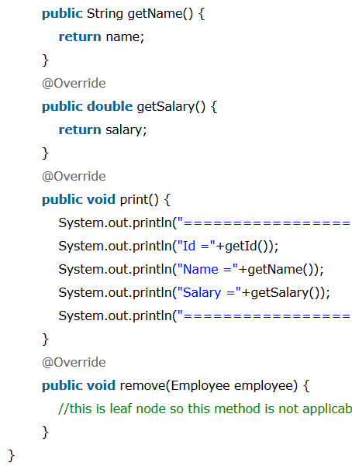
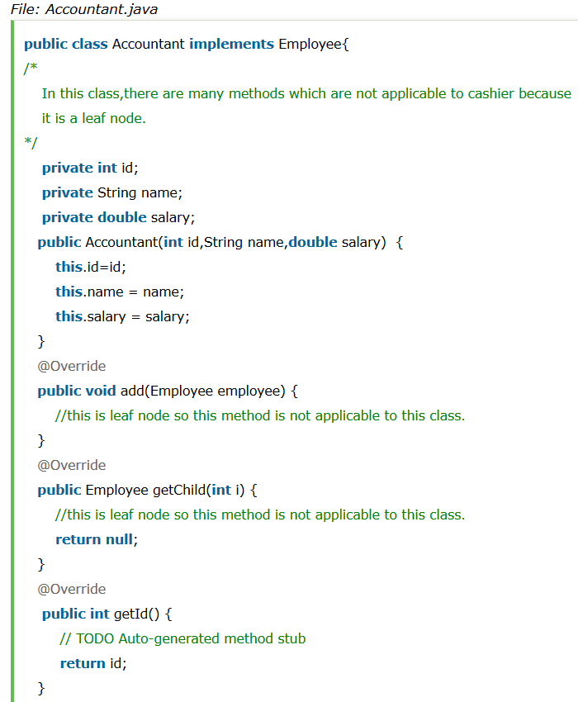

Slide 35
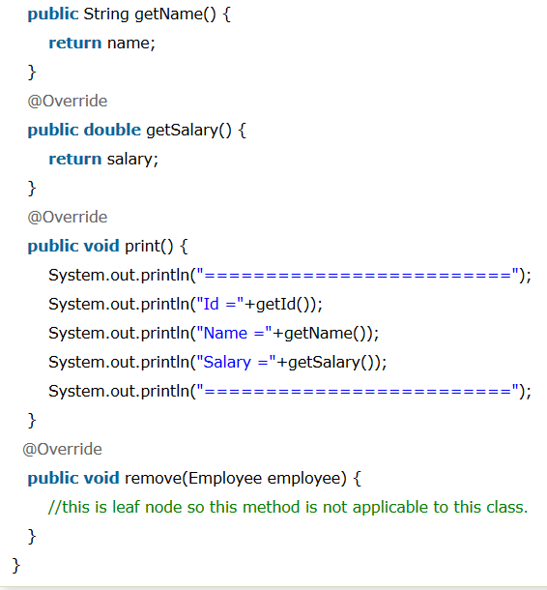

Slide 36
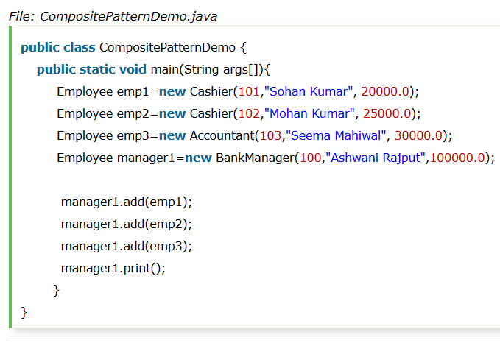

Slide 37
Consequences
Makes the client simple
Easier to add new kinds of components

